Slide 1
DATABASE MANAGEMENT SYSTEM
Topic: RETAIL BANKING SYSTEM
TEAM MEMBERS:
IIT2021013(Devika.D)
IIT2021038(Udayasree.B)
IIT2021077(Bhavana.M)
IIT2021091(Sanjay Vishnoi)
IIT2021093(Ramesh Kumar)

Slide 2
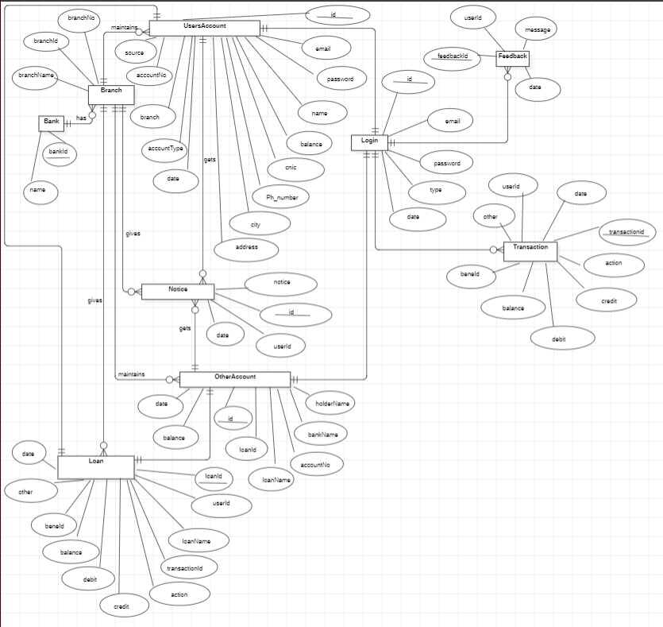
ER-DIAGRAM FOR RETAIL BANKING SYSTEM

Slide 3








TABLES IN RBS
Branch
Contains branchid, branch No, branch name .
Notice
Contains id, userid,notice,date
Feedback
Other Accounts
Contains id, accountNo,bankName, holderName,balance,date,
loanid,loanName
Contains feedbackId, message, userId, and date.
Retail Bank System
Loan
Contains loanid, userid,loanName,transactionId, credit, debit, balance, and date.
Transaction
Contains transactionId,credit, debit, balance,userid and date
Login
User Account
Contains id, email,password,type,date
Contains id,email,password,name,balance,
,accountNo,branch,
accountType and date

Slide 4
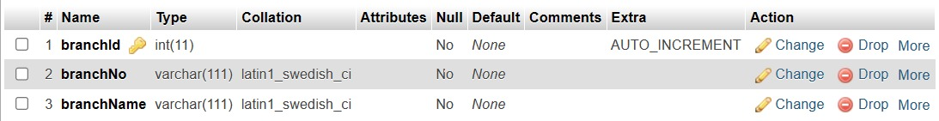
Table: BRANCH
Contains ENTITIES like branchid, branchNo,branchname.

Slide 5
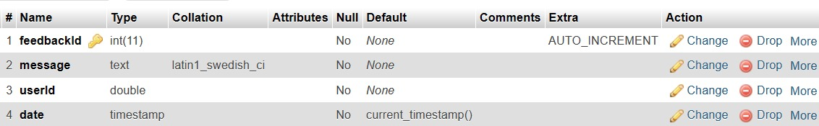


Table: FEEDBACK
Contains ENTITIES like feedbacked, message,userid, and date

Slide 6
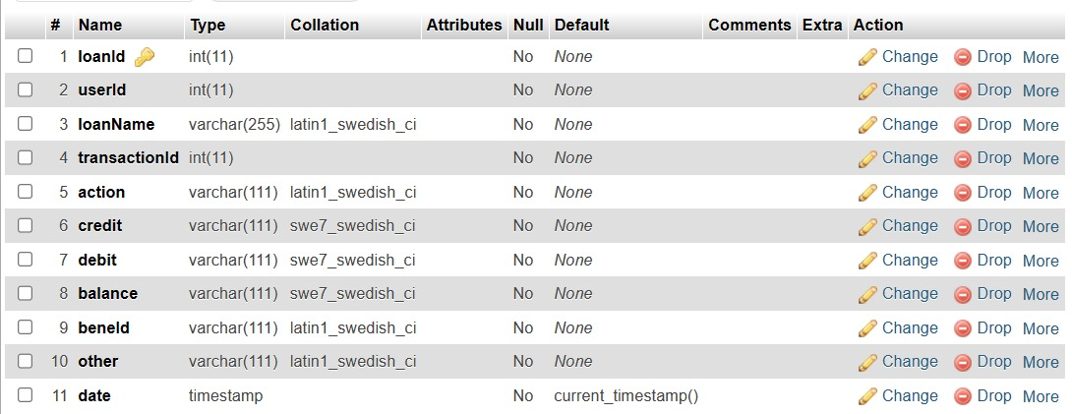

Table: LOAN
Contains ENTITIES like loaned,userid,loanName,transactionId,balance, etc

Slide 7
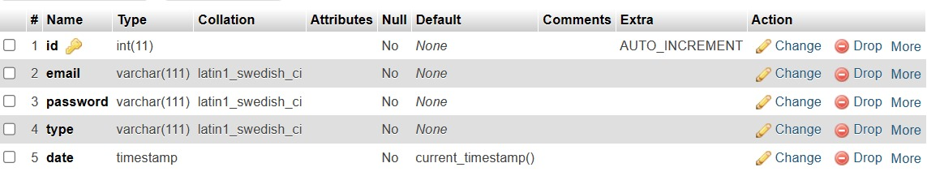

Table: LOGIN
Contains ENTITIES like id, email, password, type, and date.

Slide 8
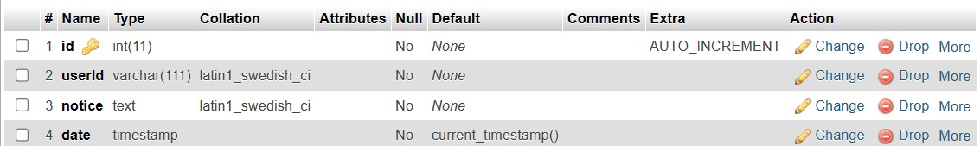

Table: NOTICE
Contains ENTITIES like id, userid, notice, and date

Slide 9
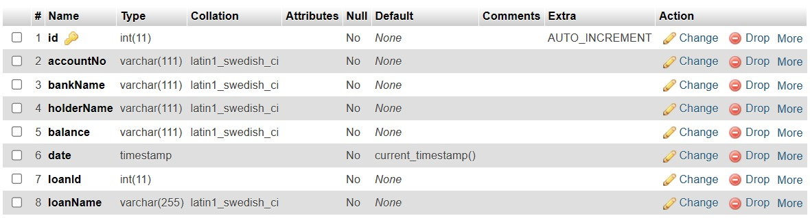

Table: OTHER ACCOUNTS
Contains ENTITIES like id,accountNo,bankName,holderName,balance etc

Slide 10
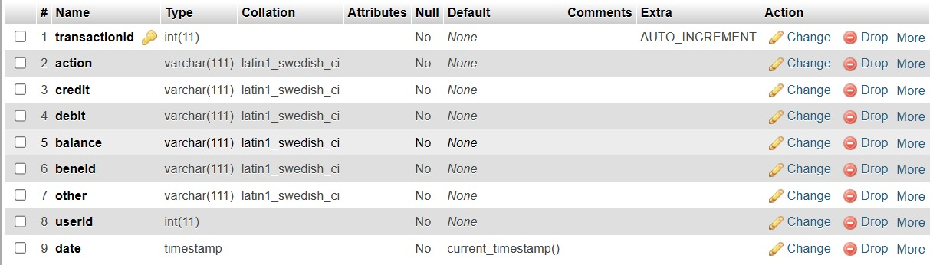
Table: TRANSACTION
Contains ENTITIES like transactionId, credit, debit, balance,userId, etc

Slide 11
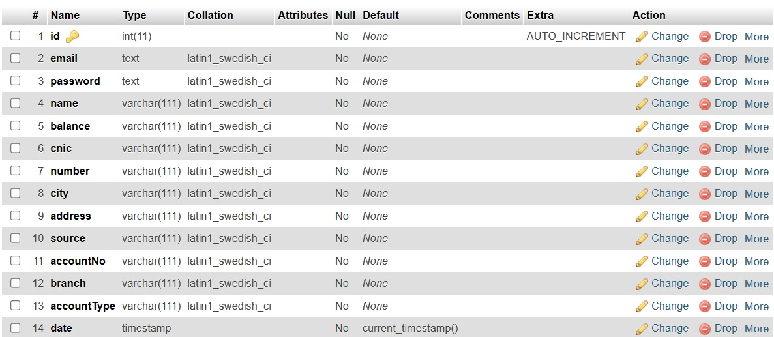

Table: USER ACCOUNT
Contains ENTITIES like id, email,password, name,balance, etc

Slide 12
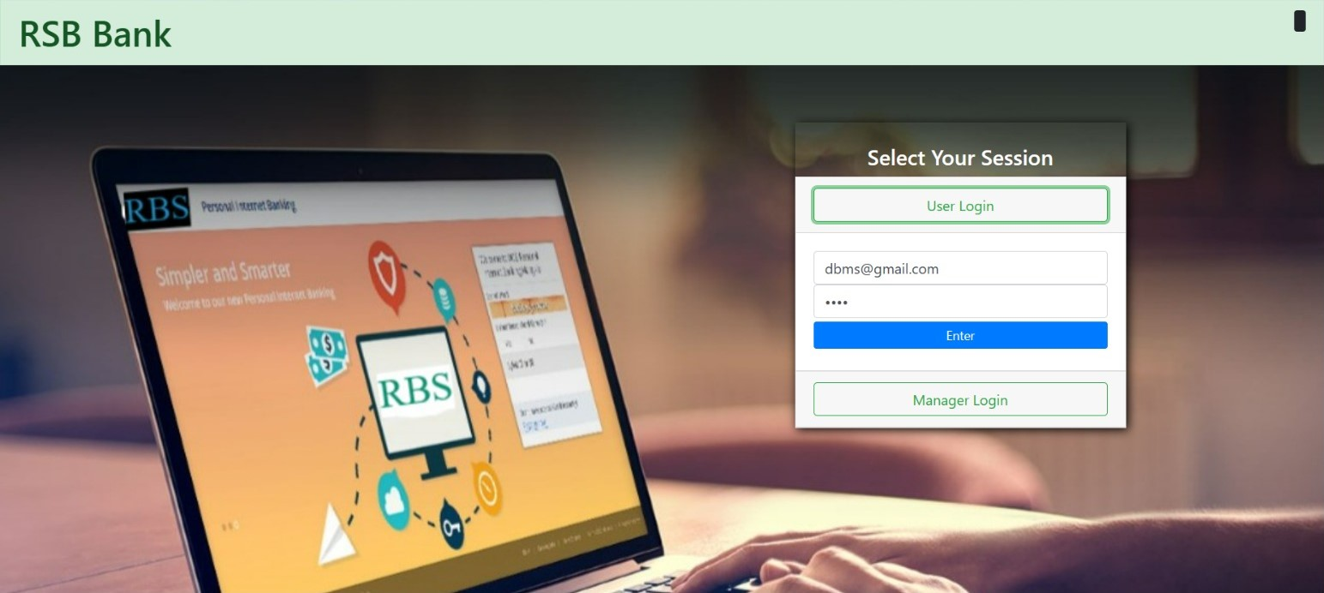
Project web pages
USER PART→ user will login and perform all the functionalities

Slide 13
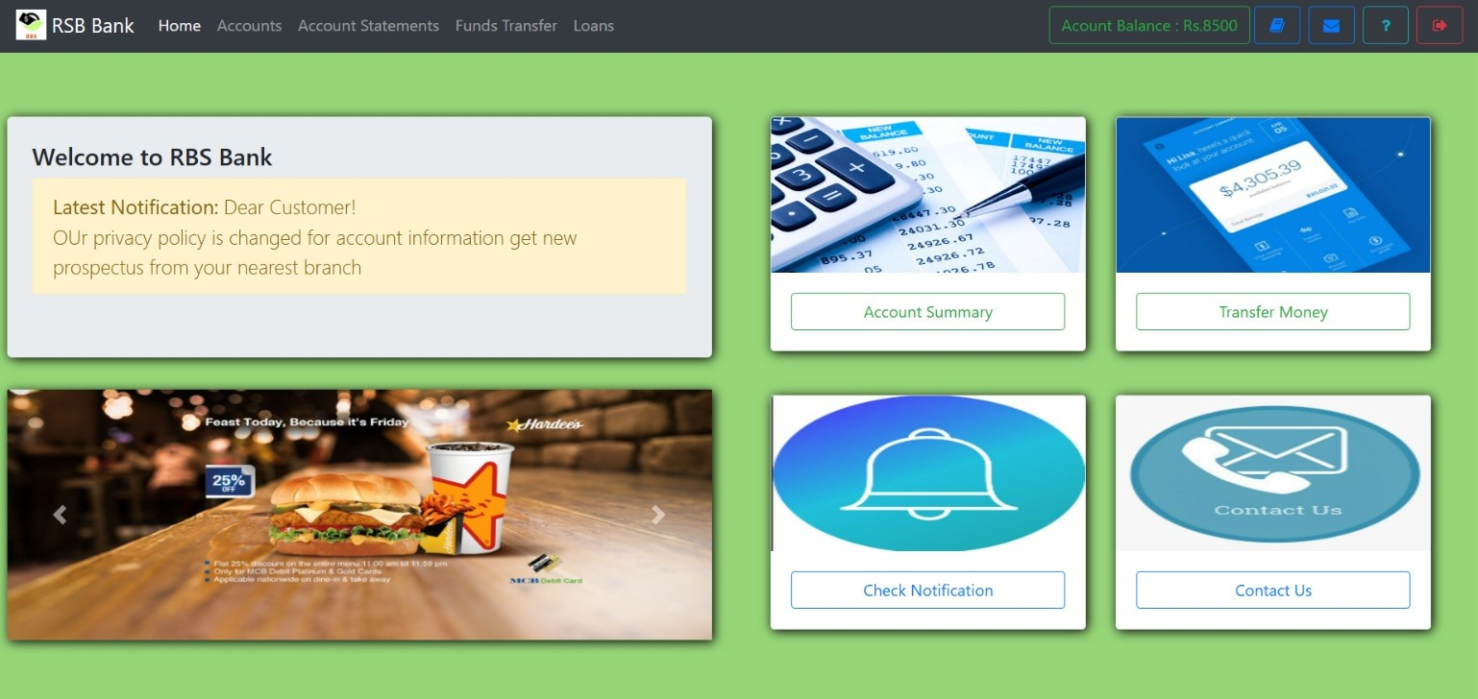

Slide 14
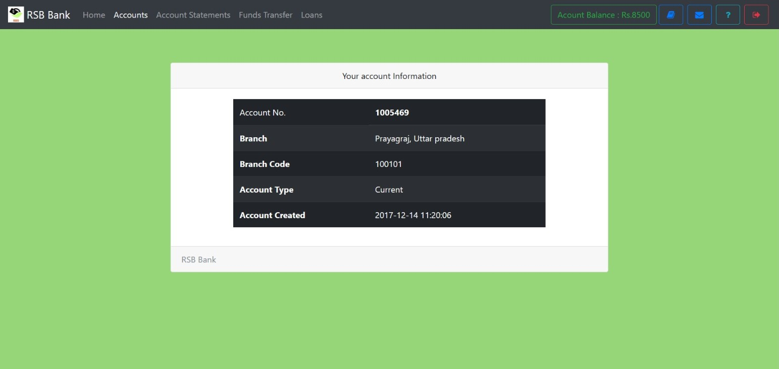

Slide 15
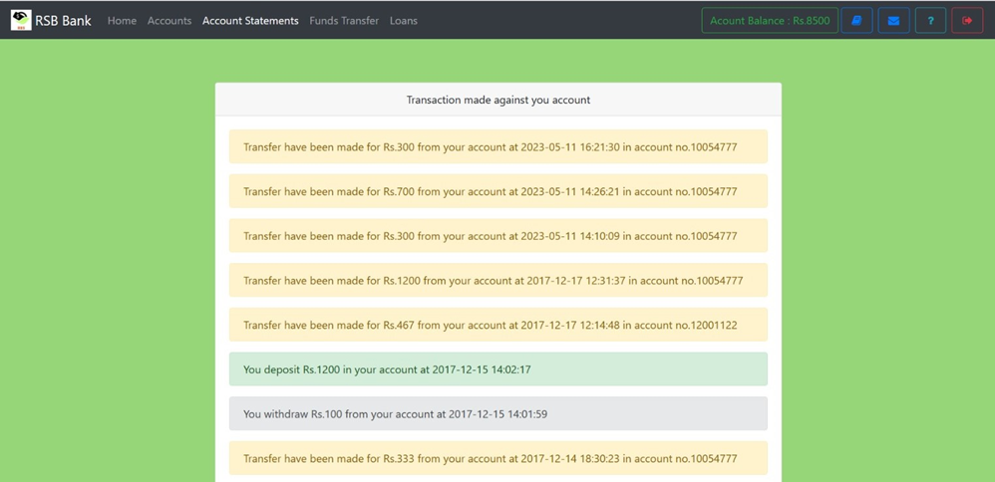

Slide 16
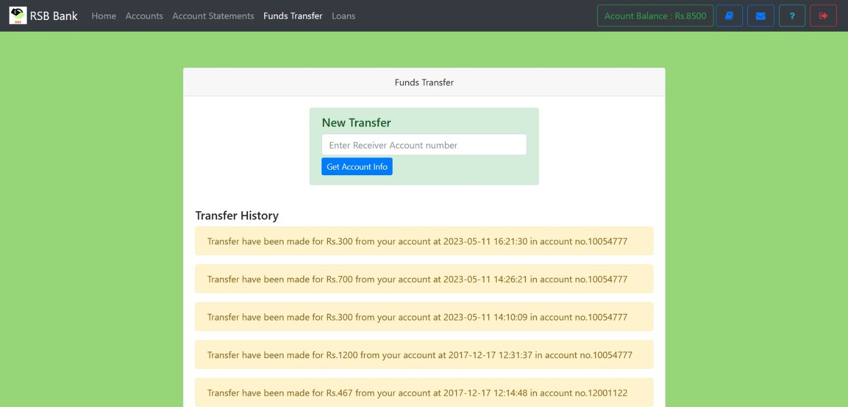

Slide 17
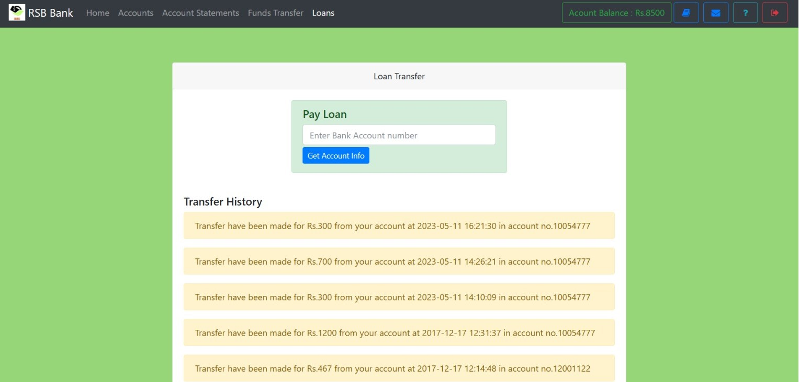

Slide 18
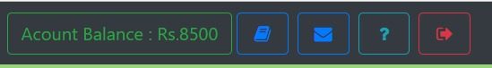
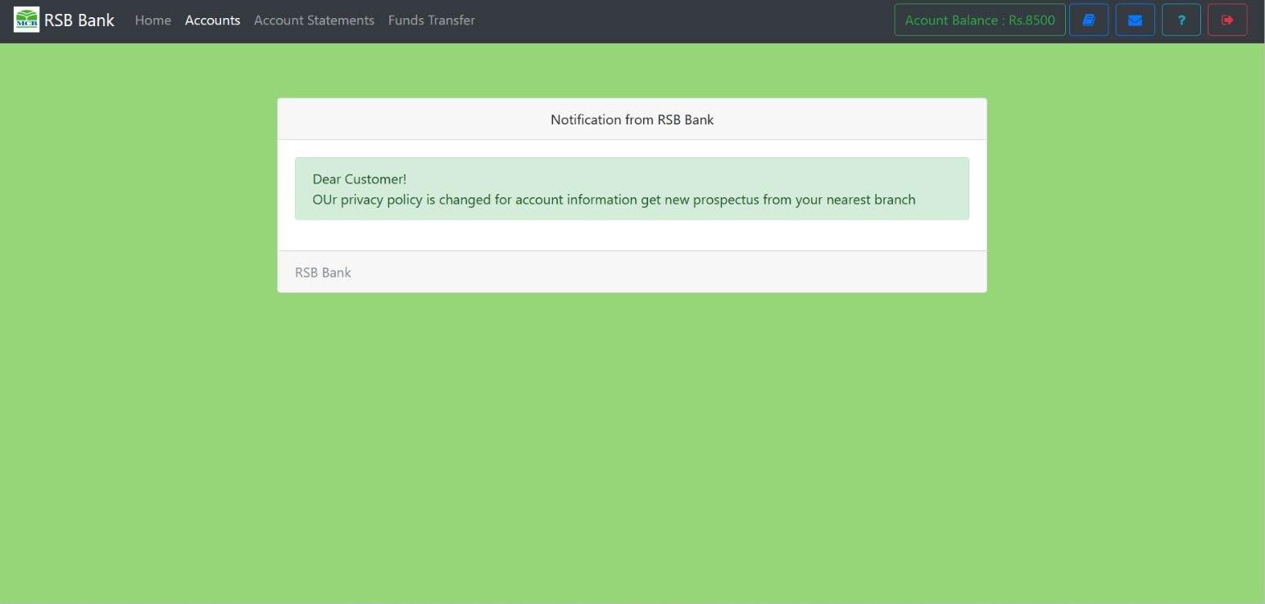

Slide 19
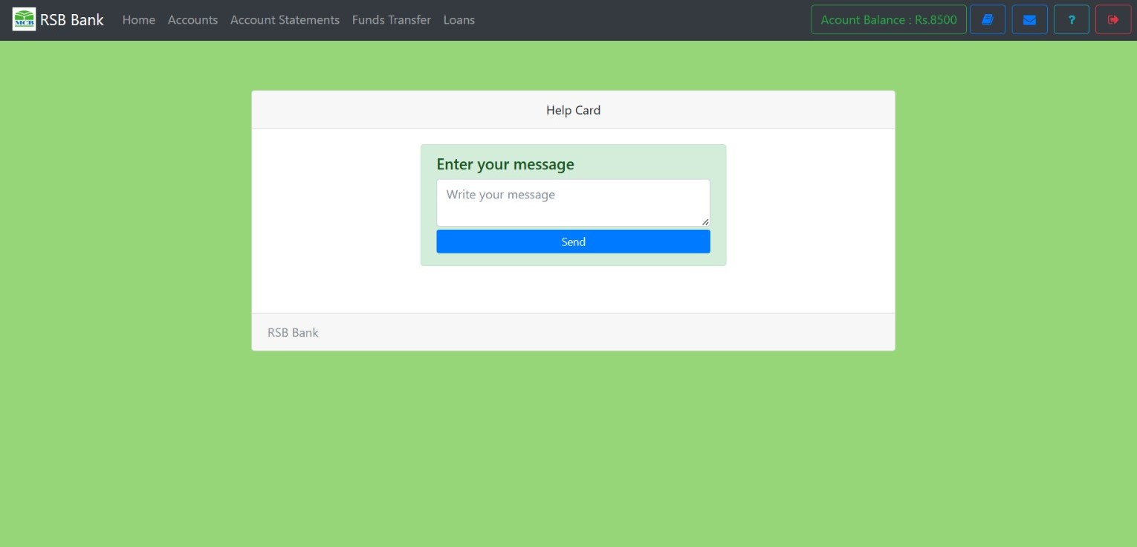

Slide 20
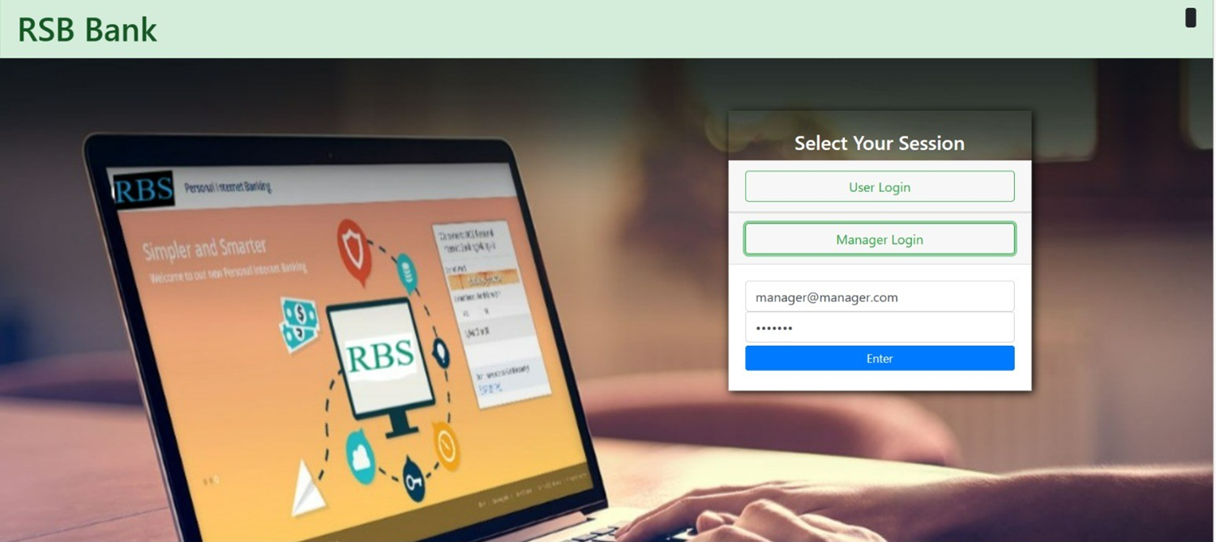
MANAGER’S PART-> Manager will do login and perform their functionalities

Slide 21
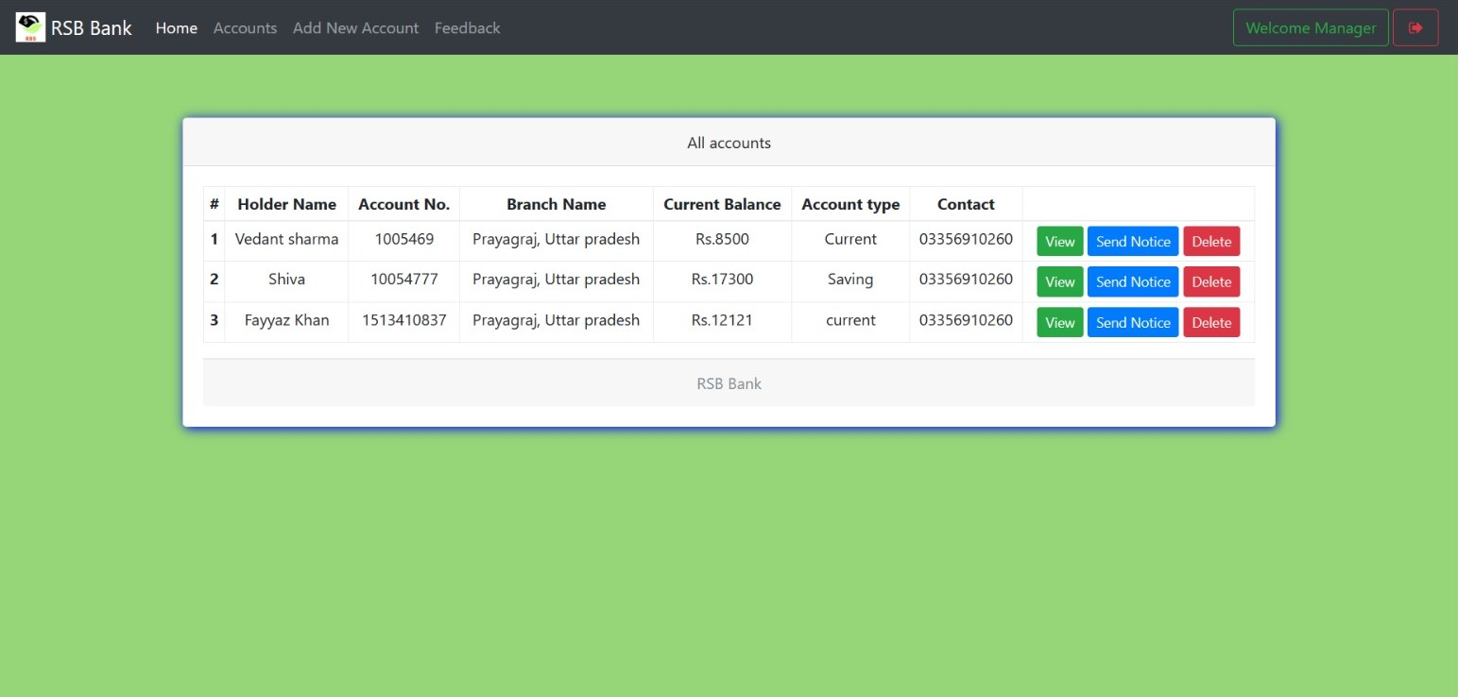

Slide 22
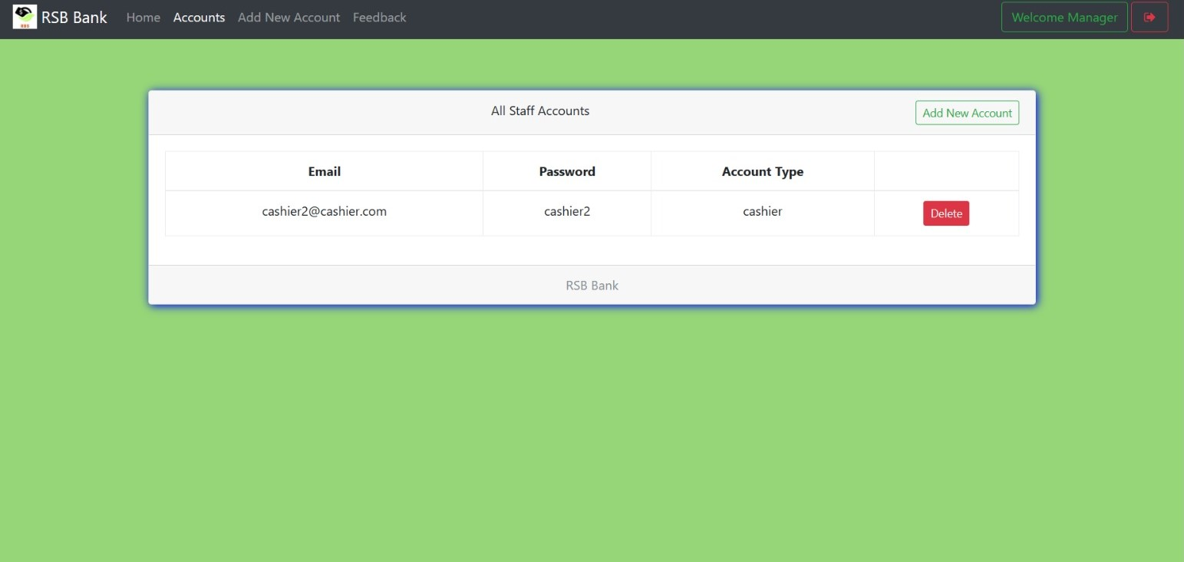

Slide 23
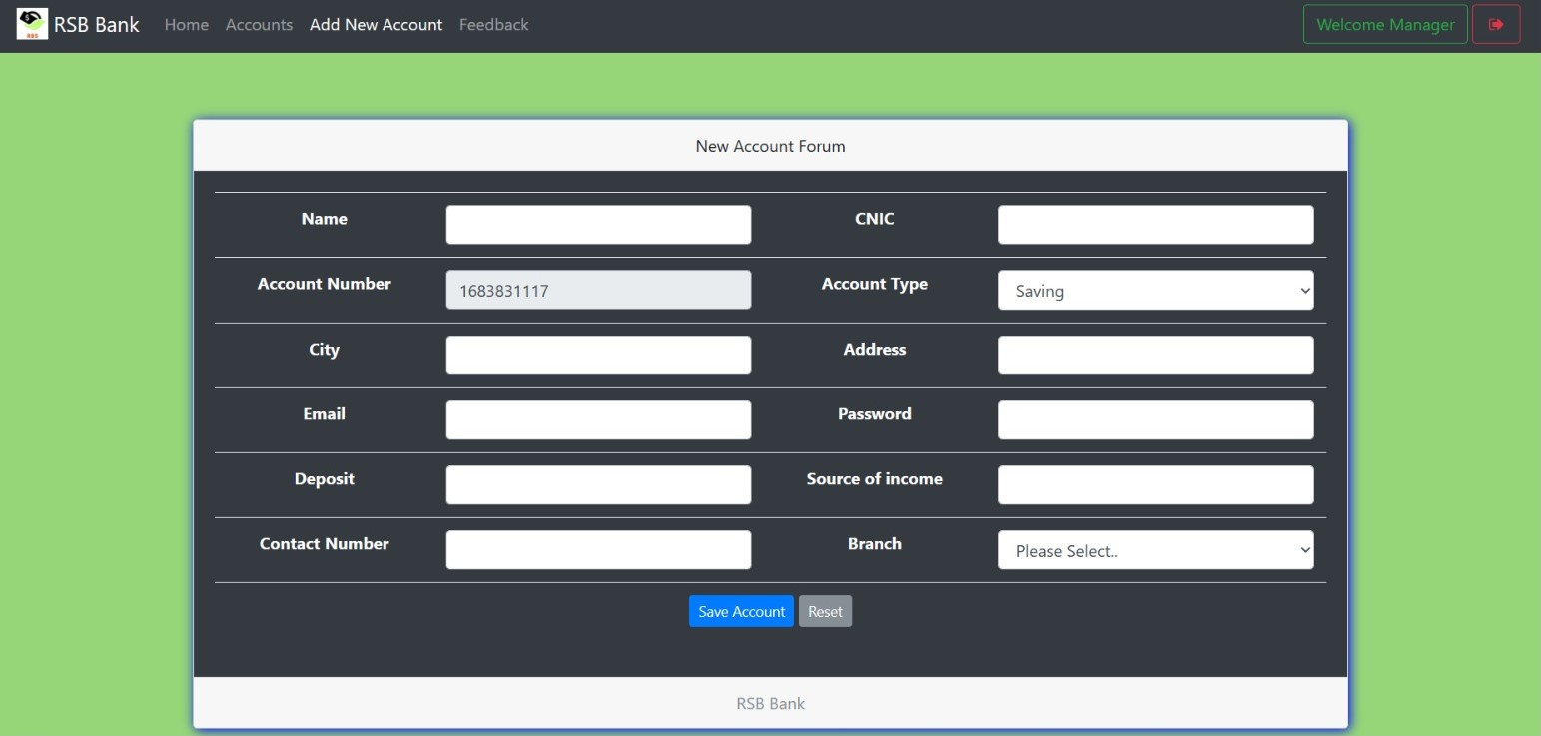

Slide 24
